Slide 1


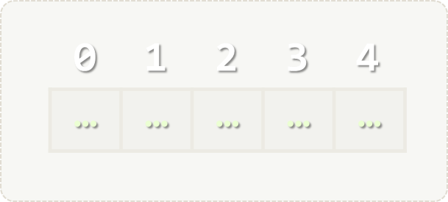

Lists
Processing Variable-Length Sequences of Elements
Programming Fundamentals
SoftUni Team
Technical Trainers
Software University
http://softuni.bg

Slide 2

Table of Contents
Lists
Reading Lists from the Console
Sorting Lists and Arrays

Slide 3
Have a Question?
sli.do #tech-softuni

Slide 4
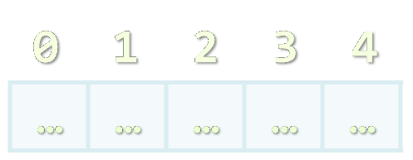
Lists
Arrays with Variable Length

Slide 5
List<T> – Overview
List<T> holds a list of elements of any type T
var names = new List<string>(); // Create a list of strings
names.Add("Peter");
names.Add("Maria");
names.Add("George");
foreach (var name in names)
Console.WriteLine(name); names.Remove("Maria");
Console.WriteLine(String.Join(", ", names));

Slide 6
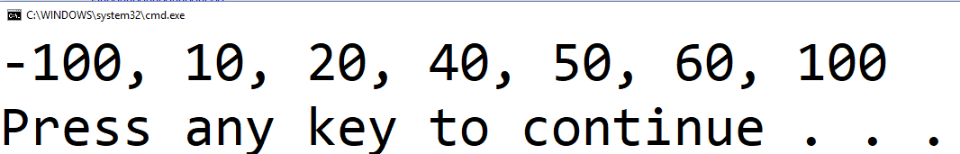
List<T> – Overview (2)
var nums = new List<int> { 10, 20, 30, 40, 50, 60};
nums.RemoveAt(2);
nums.Add(100);
nums.Insert(0, -100);
Console.WriteLine(String.Join(", ", nums));

Slide 7
List<T> – Data Structure
List<T> holds a list of elements (like array, but extendable)
Provides operations to add / insert / remove / find elements:
Add(element) – adds an element to the List<T>
Count – number of elements in the List<T>
Remove(element) – removes an element (returns true / false)
RemoveAt(index) – removes element at index
Insert(index, element) – inserts an element to given position
Contains(element) – determines whether an element is in the list
Sort() – sorts the array in ascending order

Slide 8
Add() – Appends an Element
5
10
2
List<int>
3
0
1
Count:
2

Slide 9
Remove() – Deletes an Element
10
List<int>
2
Count:
3
2
10
5

Slide 10
Remove() – Deletes an Element
Insert() – Inserts an Element at Position
-5
List<int>
3
Count:
2
2
5

Slide 11

Reading Lists from the Console
Using for Loop or String.Split()

Slide 12
Reading Lists From the Console
First, read from the console the array length:
Next, create a list of given size n and read its elements:
int n = int.Parse(Console.ReadLine());
List<int> list = new List<int>();
for (int i = 0; i < n; i++)
{
list.Add(int.Parse(Console.ReadLine()));
}

Slide 13
Reading List Values from a Single Line
Lists can be read from a single line of space separated values:
string.Split(' ') splits string by space and produces a collection
2 8 30 25 40 72 -2 44 56
string values = Console.ReadLine();
List<string> items = values.Split(' ').ToList();
List<int> nums = new List<int>();
for (int i = 0; i < items.Count; i++)
nums.Add(int.Parse(items[i]));
Convert a collection into List
Do everything at once
var items = Console.ReadLine().Split(' ') .Select(int.Parse).ToList();

Slide 14
Printing Lists on the Console
Printing a list using a for-loop:
Printing a list using a String.Join(…):
List<string> list = new List<string>() {
"one", "two", "three", "four", "five", "six"};
for (int index = 0; index < list.Count; index++)
Console.WriteLine("arr[{0}] = {1}", index, list[index]);
List<string> list = new List<string>() {
"one", "two", "three", "four", "five", "six"};
Console.WriteLine(String.Join("; ", list));

Slide 15



Sorting Lists and Arrays

Slide 16
Sorting Lists
Sorting a list == reorder its elements incrementally
List items should be comparable, e.g. numbers, strings, dates, …
var names = new List<string>() {"Nakov", "Angel", "Ivan", "Atanas", "Boris" };
names.Sort();
Console.WriteLine(string.Join(", ", names));
// Angel, Atanas, Boris, Ivan, Nakov
names.Sort(); names.Reverse();
Console.WriteLine(string.Join(", ", names));
// Nakov, Ivan, Boris, Atanas, Angel
Sort in natural (ascending) order
Sort in descending order

Slide 17
Problem: Sort Numbers
Read a list of decimal numbers and sort them
Print the sorted list as shown below:
8 2 7 3
2 <= 3 <= 7 <= 8
1 1
1 <= 1
2 4 -9
-9 <= 2 <= 4
1 -0.5
-0.5 <= 1
Check your solution here: https://judge.softuni.bg/Contests/Practice/Index/397#4

Slide 18
Solution: Sort Numbers
List<double> nums = Console.ReadLine()
.Split(' ')
.Select(double.Parse)
.ToList();
nums.Sort();
Console.WriteLine(string.Join(" <= ", nums));
Read the list of numbers
Sort the list
Print the list
Check your solution here: https://judge.softuni.bg/Contests/Practice/Index/397#4

Slide 19
Problem: Square Numbers
Read a list of integers and print all square numbers in the list in descending order
A "square number" s is a square of some other integer: s = x * x
3 16 4 5 6 8 9
16 9 4
Find in Internet how to calculate a square root
var squares = new List<int>();
foreach (var num in nums)
if (√num == (int)√num) squares.Add(num);
// TODO: sort squares descending and print them
Check your solution here: https://judge.softuni.bg/Contests/Practice/Index/397#5

Slide 20
Problem: Count Numbers
Read a list of integers in range [0…1000] and print them in ascending order along with their number of occurrences
8 2 2 8 2 2 3 7
10 8 8 10 10
0 5 0 0 1 0
2 -> 4
3 -> 1
7 -> 1
8 -> 2
8 -> 2
10 -> 3
0 -> 4
1 -> 1
5 -> 1
Check your solution here: https://judge.softuni.bg/Contests/Practice/Index/397#6

Slide 21
Solution: Count Numbers (Simple)
var nums = Console.ReadLine().Split(' ')
.Select(int.Parse).ToList();
var counts = new int[nums.Max() + 1];
foreach (var num in nums)
counts[num]++;
for (int i = 0; i < counts.Length; i++)
{
if (counts[i] > 0)
Console.WriteLine($"{i} -> {counts[i]}");
}
counts[num] holds how many times num occurs in the list
Check your solution here: https://judge.softuni.bg/Contests/Practice/Index/397#6

Slide 22
Solution: Count Numbers (by Sorting)
List<int> nums = ReadNumbers();
nums.Sort();
var pos = 0;
while (pos < nums.Count)
{
int num = nums[pos], count = 1;
while (pos + count < nums.Count &&
nums[pos + count] == num)
count++;
pos = pos + count;
Console.WriteLine($"{num} -> {count}");
}
Sort the numbers
Count how times num occurs starting from position pos
Check your solution here: https://judge.softuni.bg/Contests/Practice/Index/397#6

Slide 23

Lists – Exercises
Live Exercises in Class (Lab)

Slide 24

Summary
Lists hold a sequence of elements (variable-length)
Can add / remove / insert elements at runtime
Creating (allocating) a list:
Accessing list elements by index:
Printing list elements:
List<int> numbers = new List<int>();
var nums = new List<int>() { 1, 2, 3 };
numbers[5] = 10;
Console.Write(string.Join(" ", list));

Slide 25






SoftUni Diamond Partners

Slide 26






SoftUni Diamond Partners

Slide 27







Programming Fundamentals – Lists
https://softuni.bg/courses/csharp-web-development-basics

Slide 28
License
This course (slides, examples, demos, videos, homework, etc.) is licensed under the "Creative Commons Attribution-NonCommercial-ShareAlike 4.0 International" license

Slide 29





Trainings @ Software University (SoftUni)
Software University – High-Quality Education, Profession and Job for Software Developers
softuni.bg
Software University Foundation
http://softuni.foundation/
Software University @ Facebook
facebook.com/SoftwareUniversity
Software University Forums
forum.softuni.bg

